Slide 1
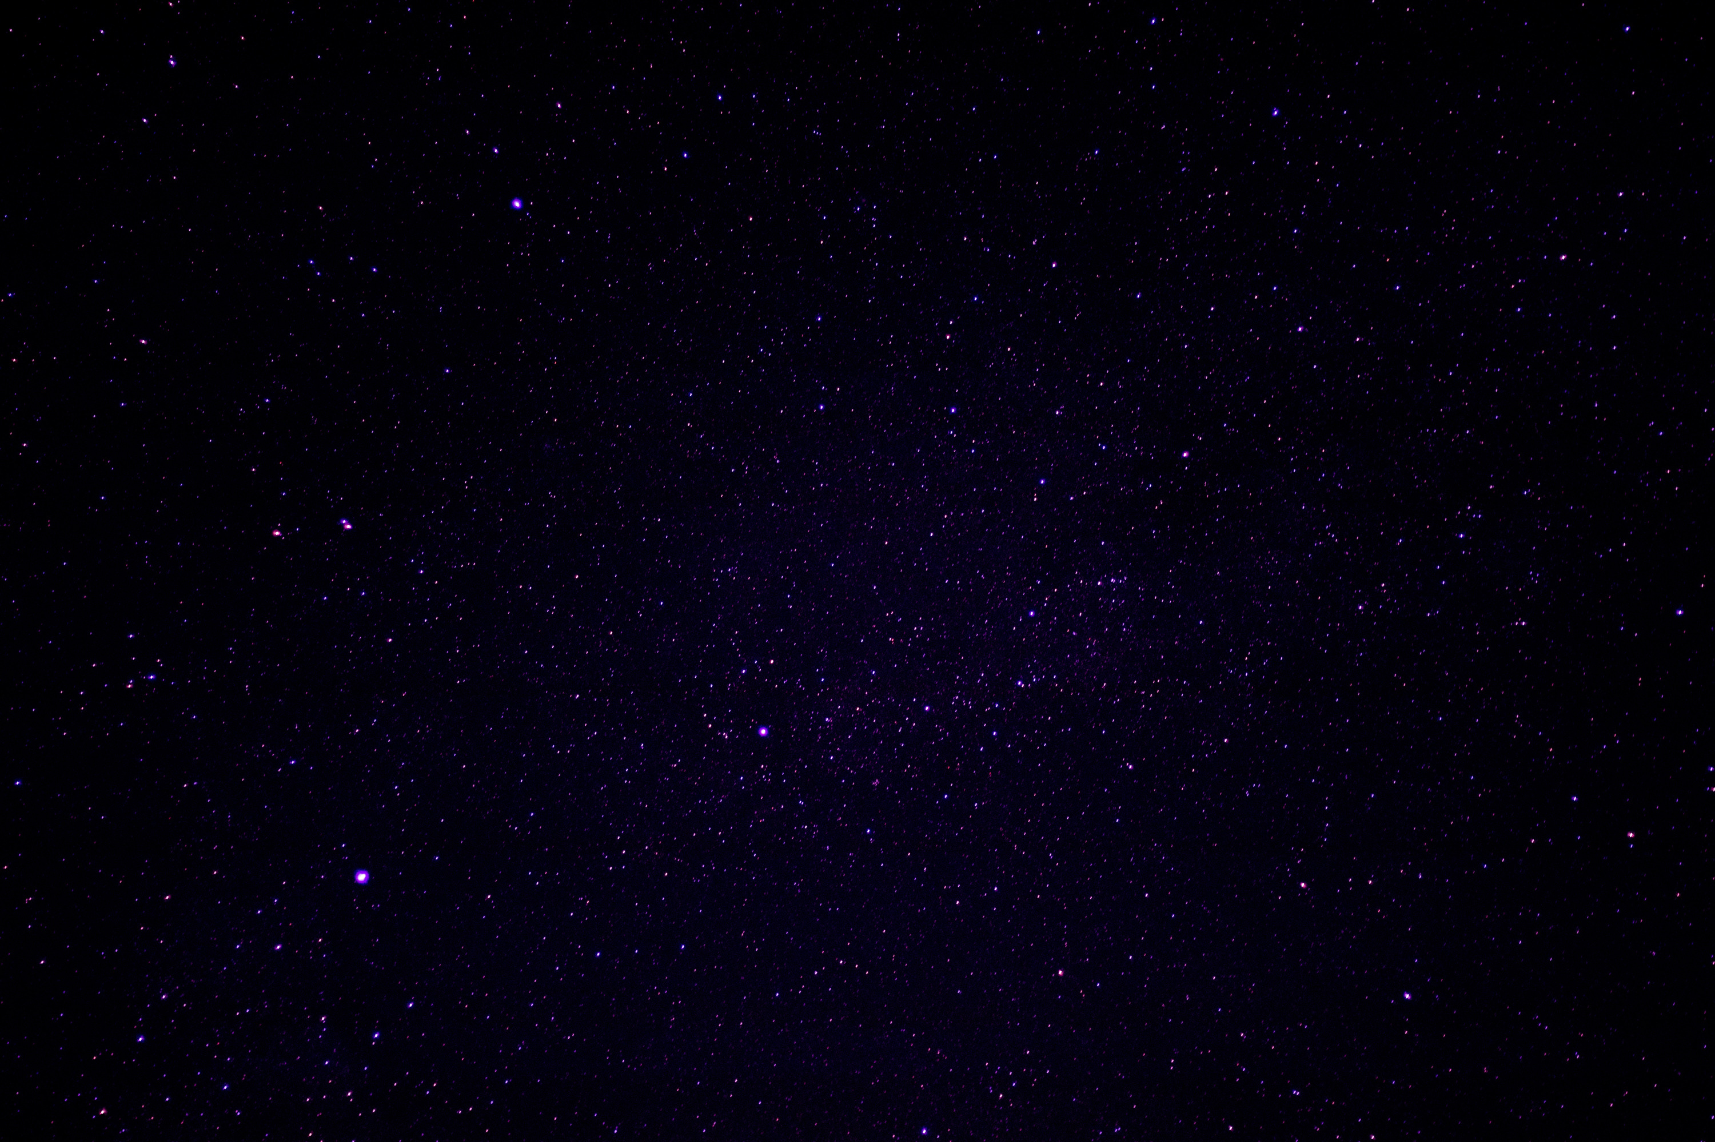




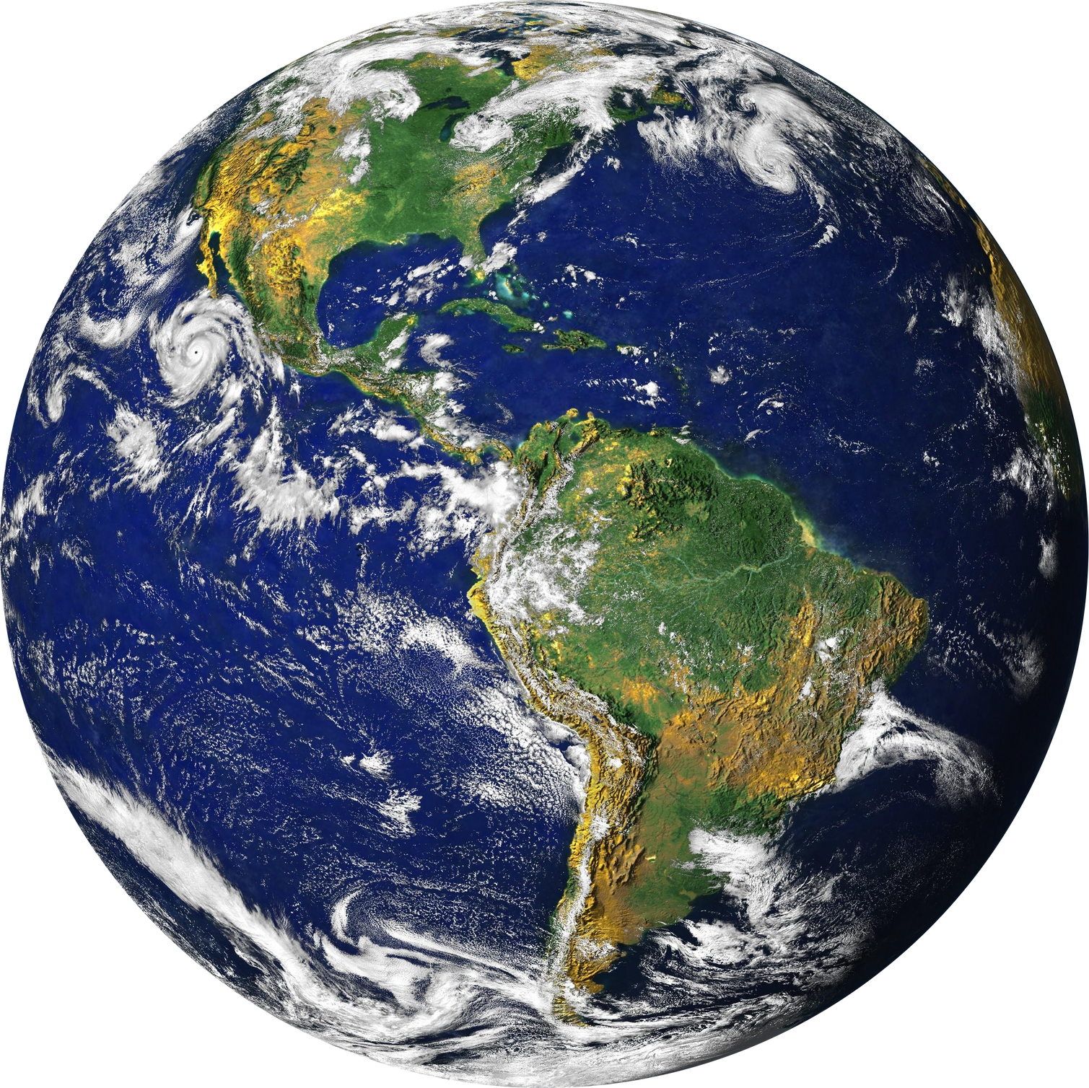
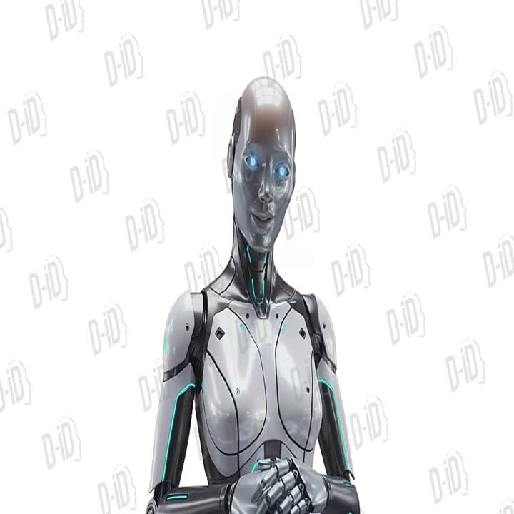
A WORLD AWAY:
HUNTING FOR EXOPLANETS WITH AI
SPACE

Slide 2
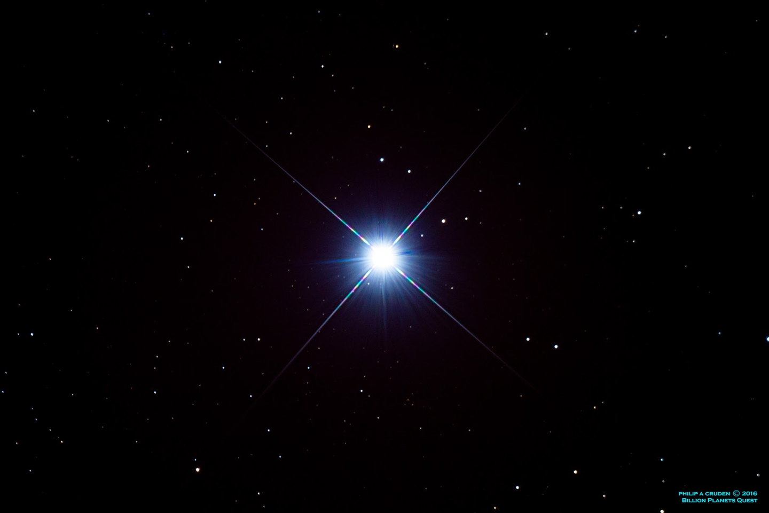
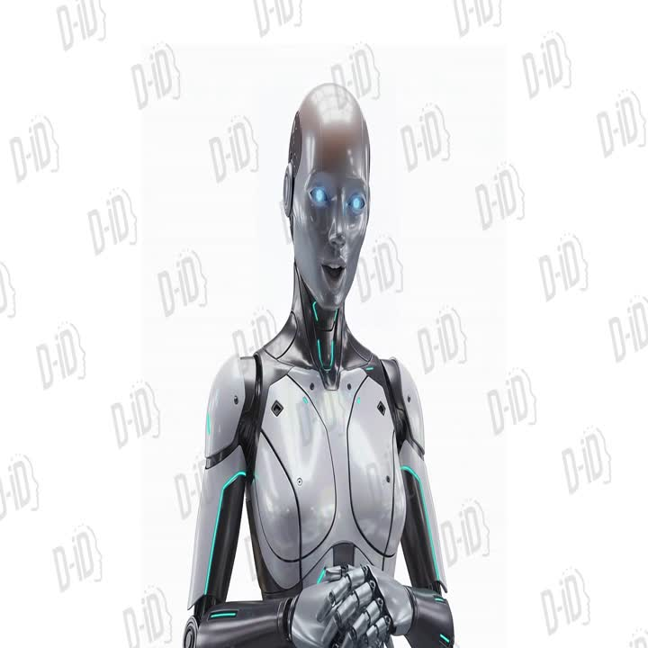
THE PROBLEM
Space telescopes send millions of signals
Checking them by hand is slow and messy
Tons of false positives waste time and resources
OBJECTIVE OUR GOAL
Model is reliable and catches promising candidates
Fewer false positives, so telescope time is saved
New habitable planets identified
Interactive 3D makes it easy to explore planets

Slide 3
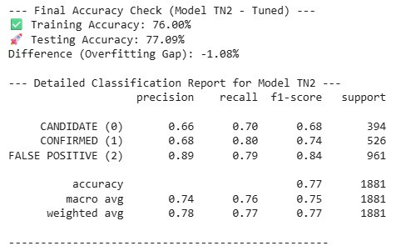
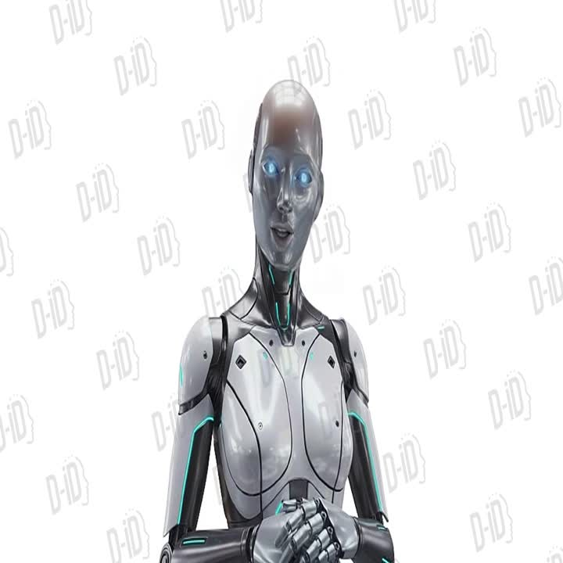
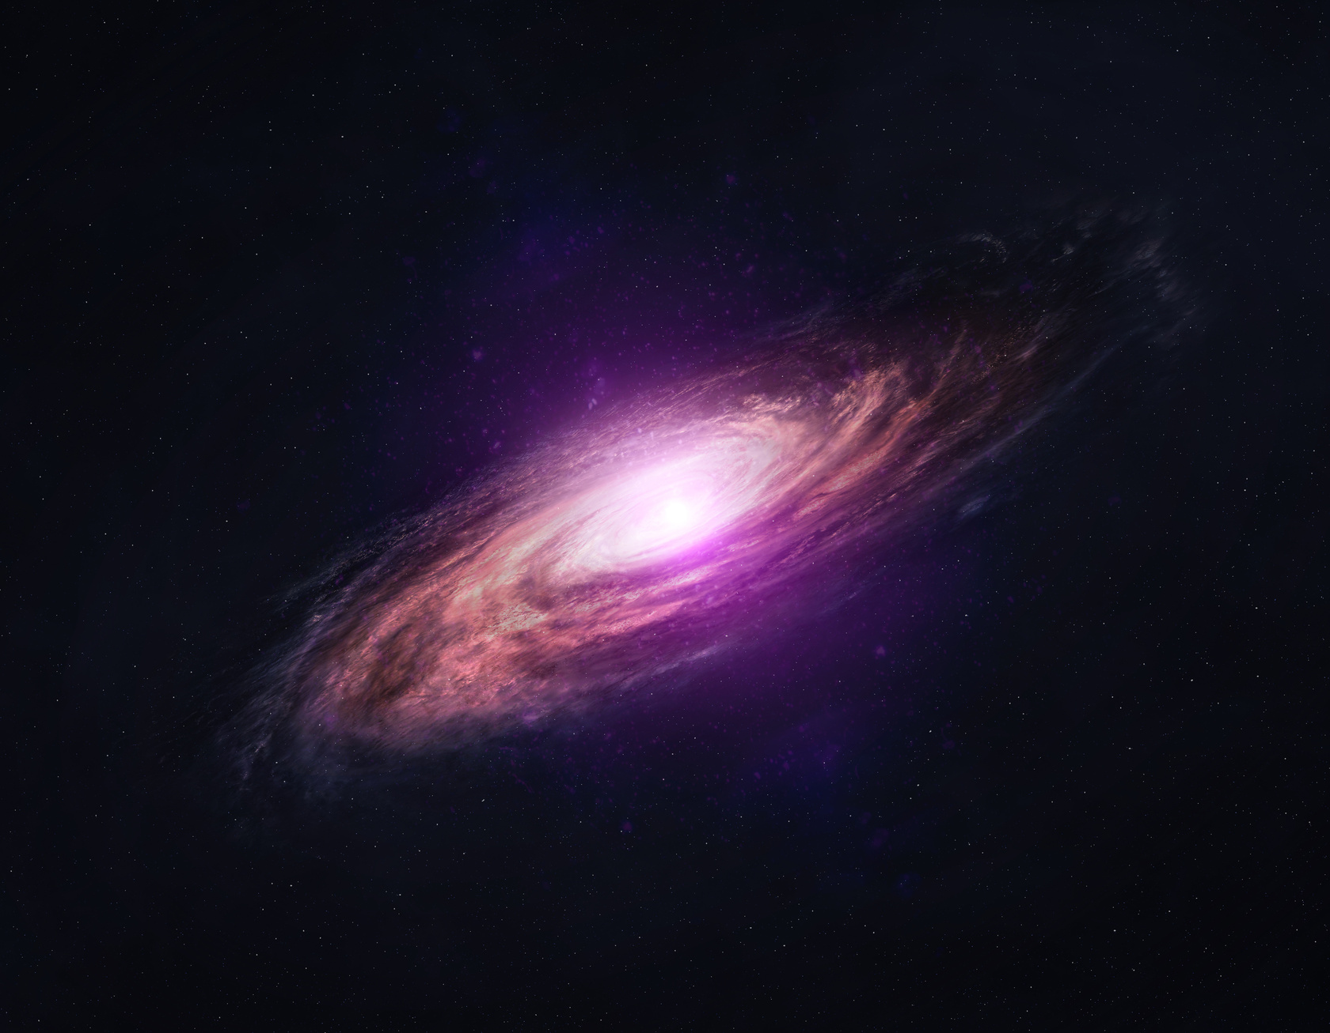
MODEL PERFORMANCE
Train Accuracy: 76% | Test Accuracy: 77% | Recall: 80%
Works well on Confirmed & Candidate planets
False positives are much lower → saves telescope time
Can spot habitable rocky planets ready for follow-up

Slide 4
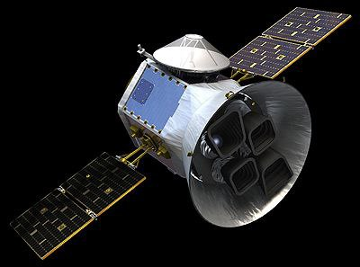
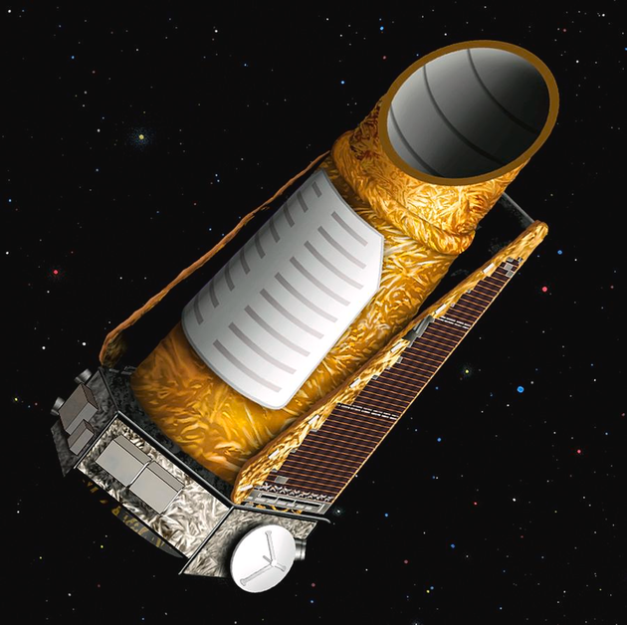
TESS
THE DATA
From Kepler , TESS dataset and archived data (K2) .
Features: orbital (period, duration, depth), stellar (radius, temp, magnitude), SNR
Cleaned to remove bad data
Some missing values fixed with KNNImputer from nearby data points
KEPLER
METHODOLOGY How We Did It
Cleaned the messy data, filled gaps with KNNImputer from nearby points
Picked the most important features
Trained TapNets, neural networksto classify signals
Checked results carefully so the model isn’t tricked by the data

Slide 5
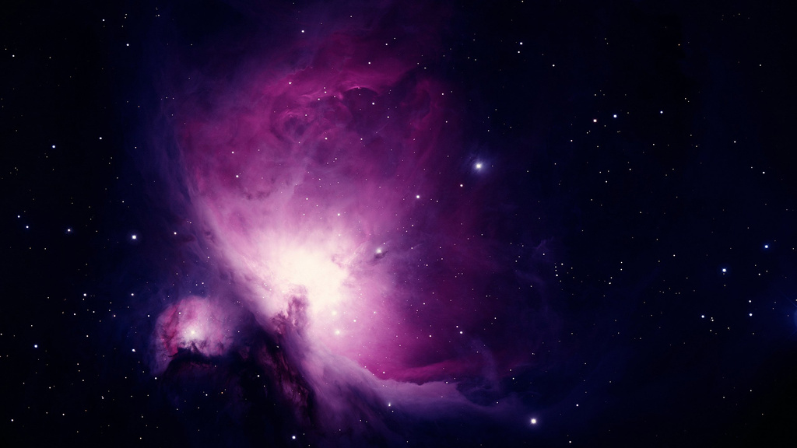
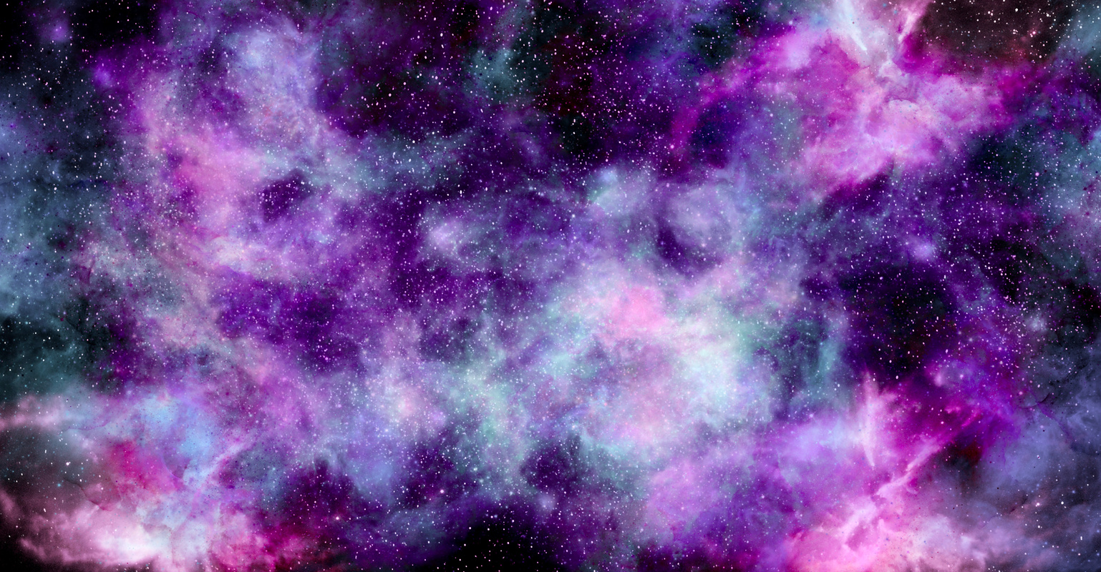
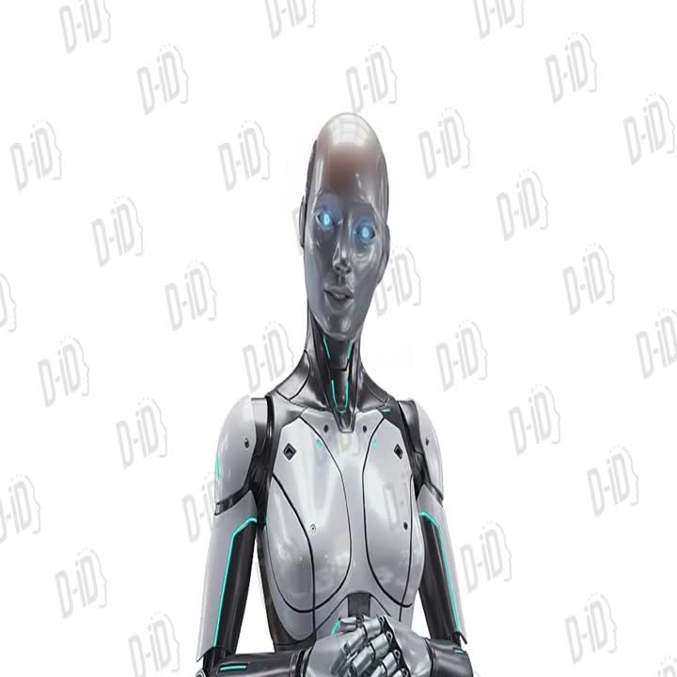
TARGET GROUP
1- THE SCIENTISTS AT SPACEX
2- TRAINERS IN THIS AGENCY

Slide 6
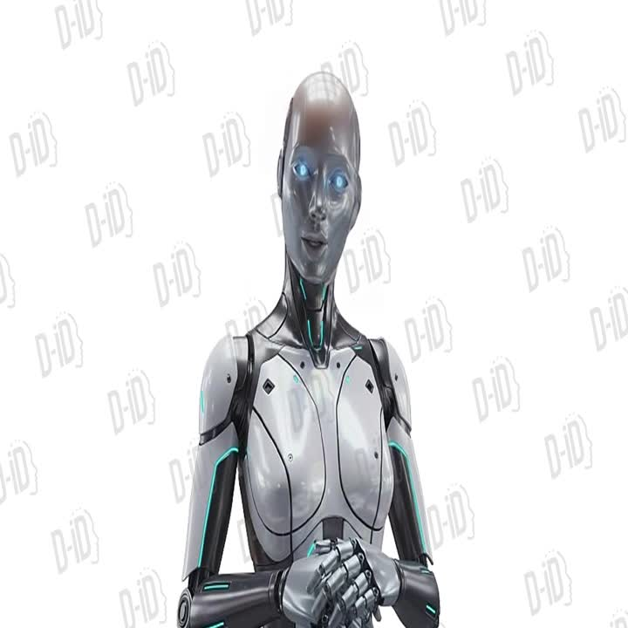
WHAT PROBLEM DOES YOUR PROJECT SOLVE?
Slowness and human effort
The technology gap

Slide 7
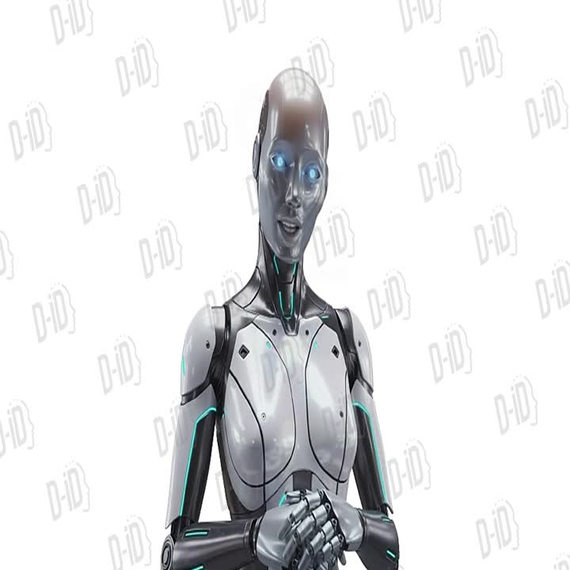
THE GEOGRAPHICAL SCOPE OF THE PROJECT
- GLOBAL

Slide 8
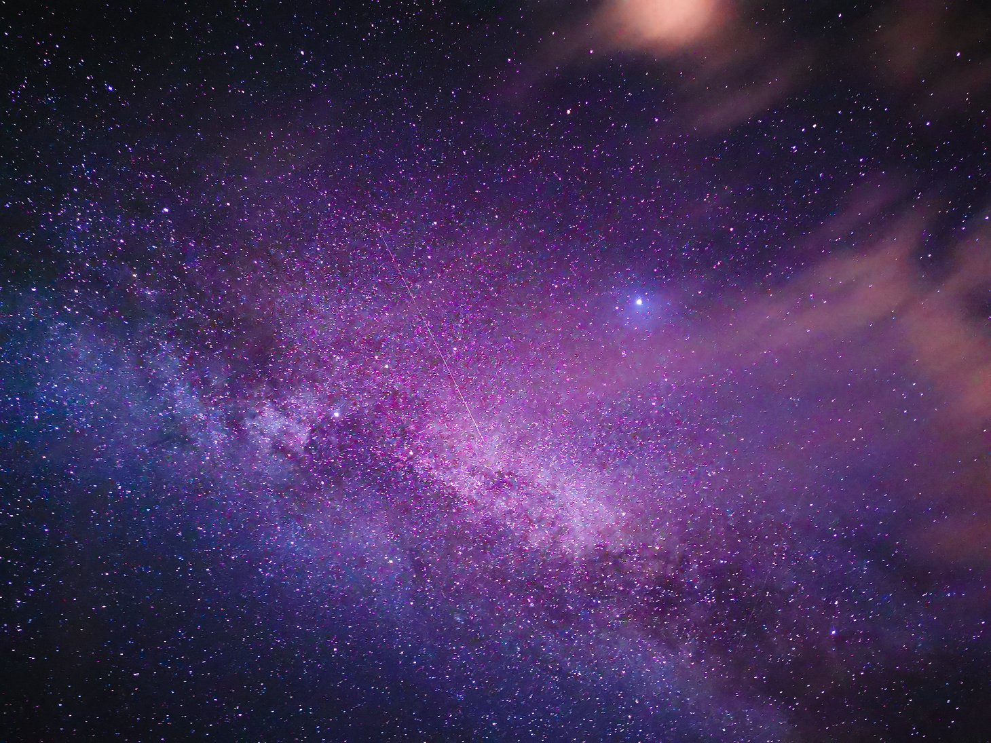
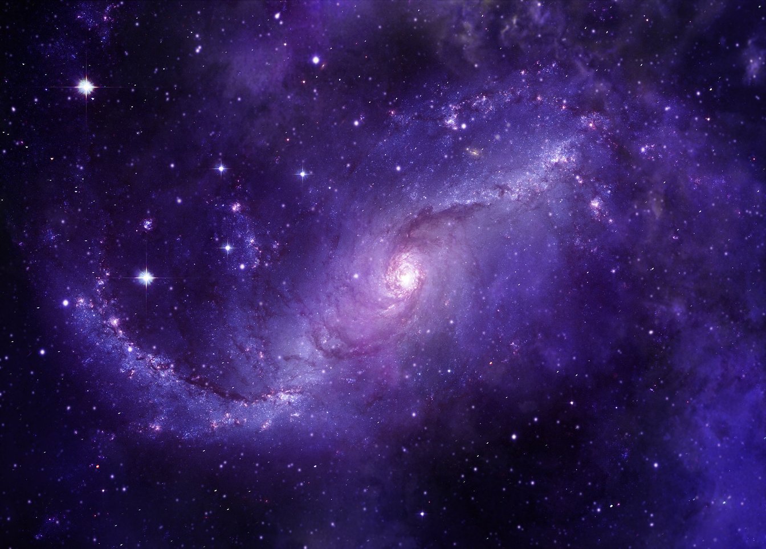
WEB INTERFACE & VISUALIZATION
CHECK OUT THE AI IN ACTION
Simple dashboard: upload telescope data, see classifications right away
3D view of promising planets
Filters to focus on habitable zones
Updates classifications in real-time

Slide 9
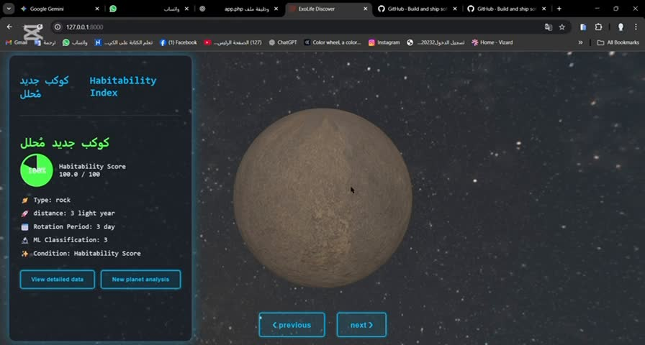

Slide 10
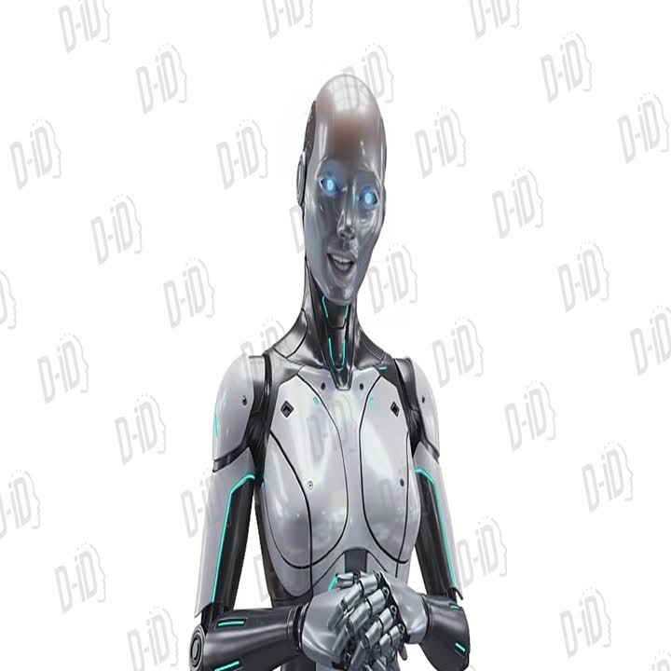
THE RIGHT TIME TO LAUNCH THE PROJECT
THE RIGHT TIME TO LAUNCH IS WHEN THE SPACEX EXPLORATION ROCKET TAKES OFF

Slide 11
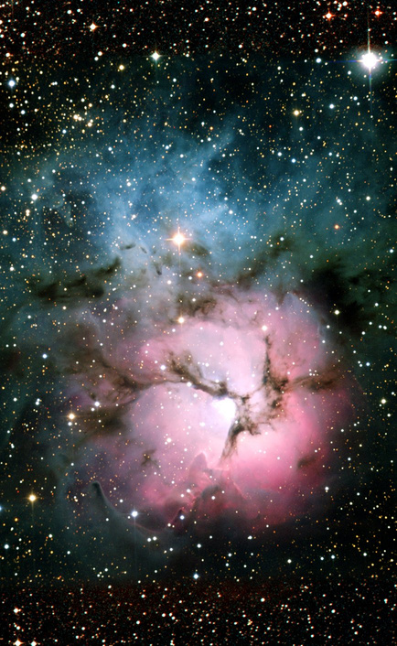
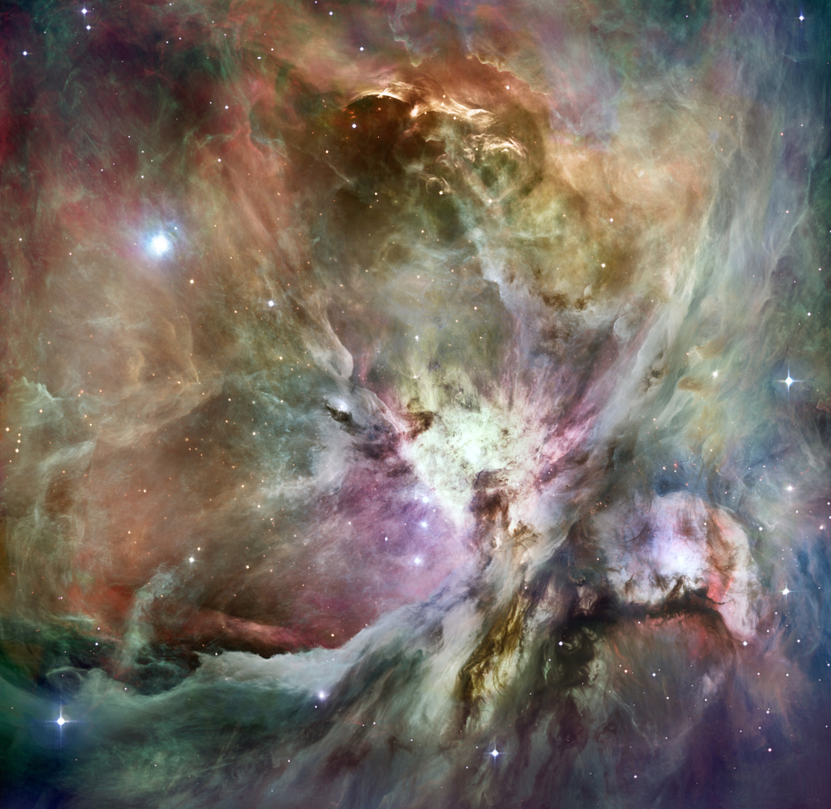
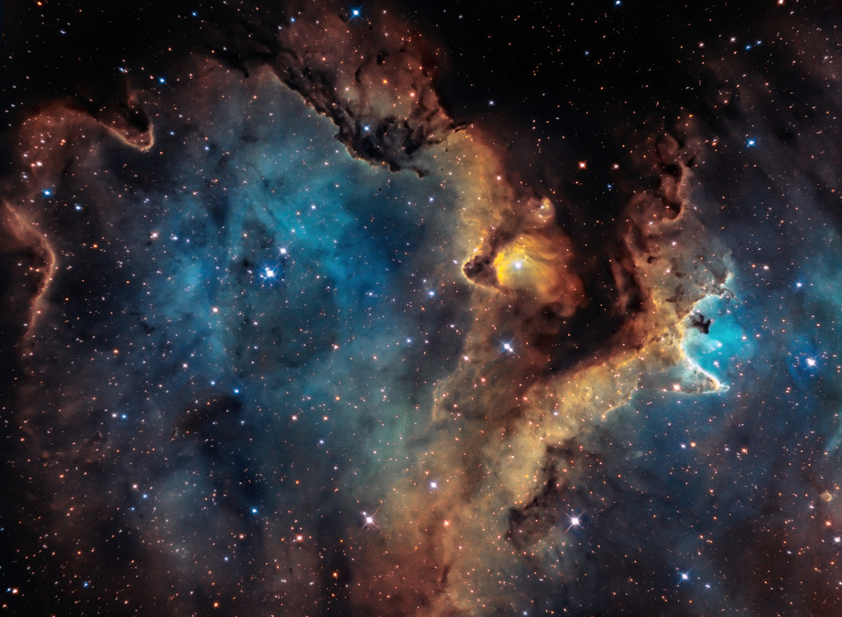
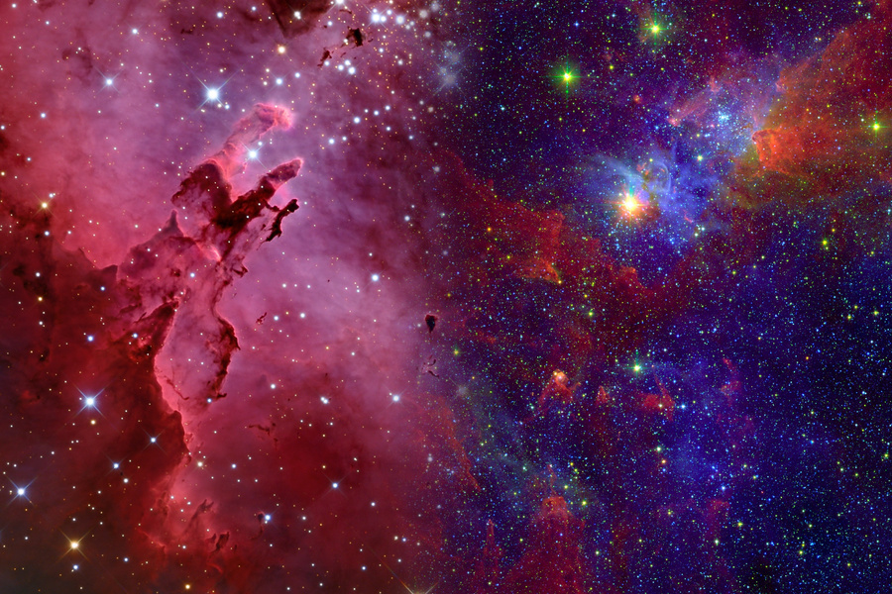
CHALLENGES & FIXES
WHAT WE FACED & HOW WE SOLVED IT
Huge data → slowed processing → cleaned & selected features
Many false positives → TapNets helped reduce them
Imbalanced classes → adjusted training carefully
Needed clear visualization → built interactive 3D view

Slide 12
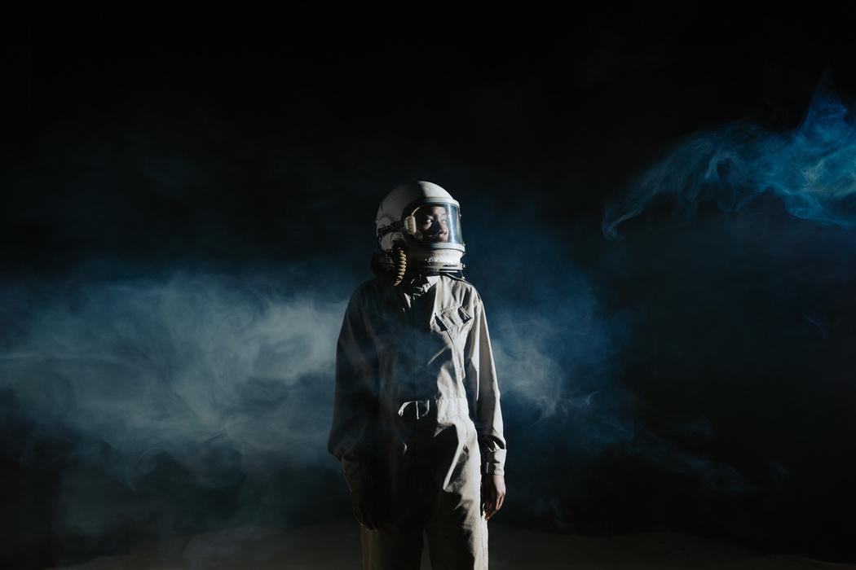
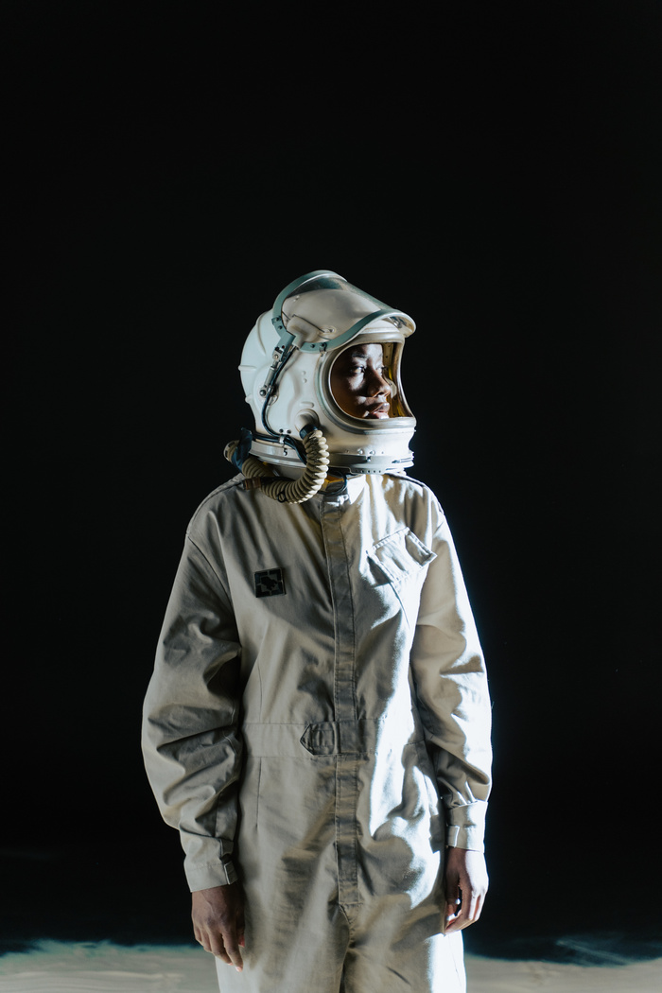
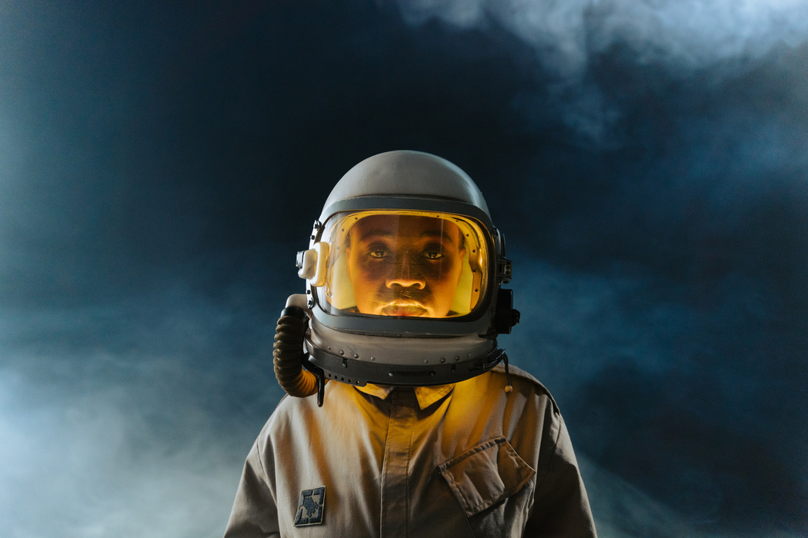
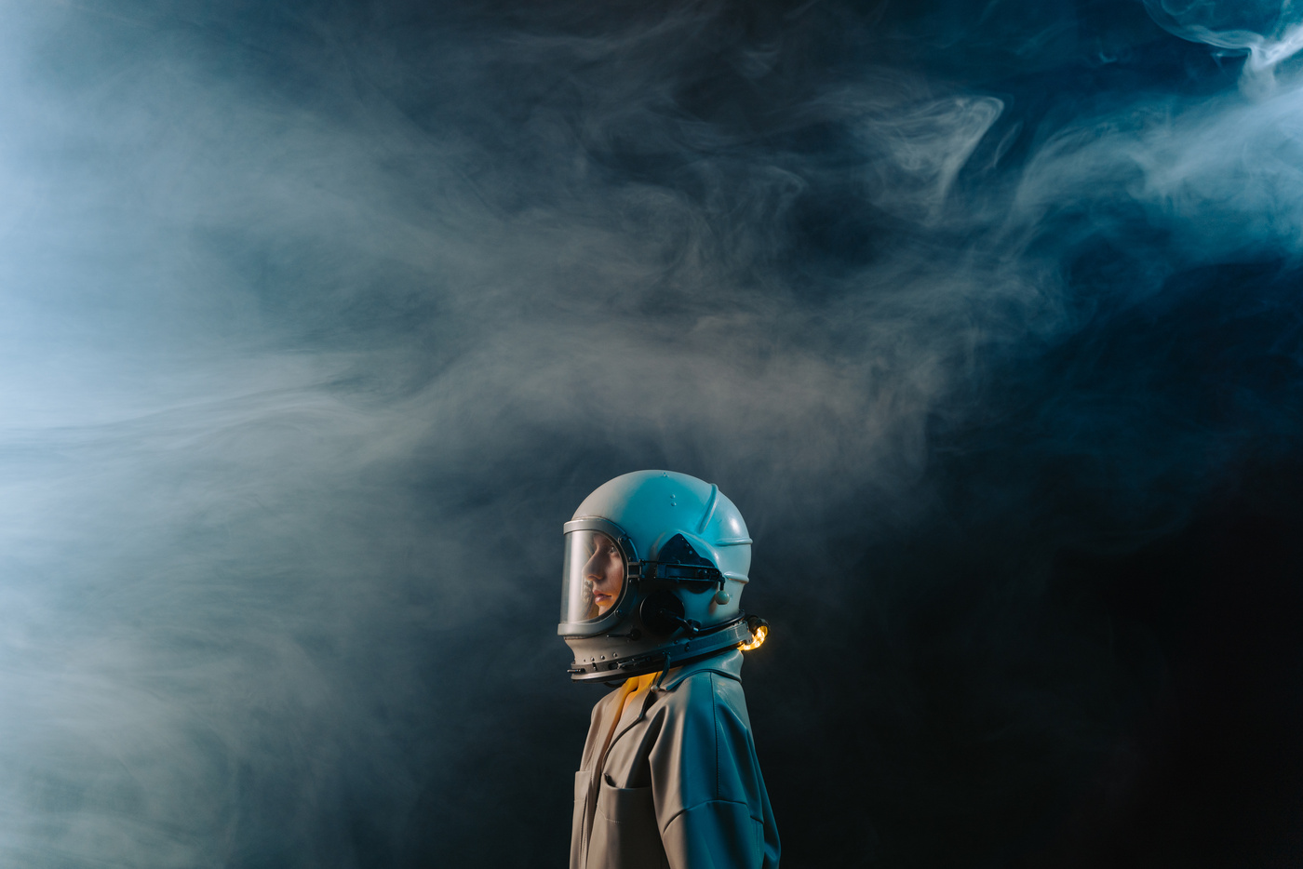
MEET OUR ASTRONAUT
MOHMMED HARB
MOHMMED ZOUBI
HAMZA Rababah
AHMAD Hosni
documentation
research
make presentation
Web developer
3d model
Make dashbords on web site
build a full website
data cleaner and make data understandable
and help us to develop model
Build Ai model and fine tinning to hyper parameters and optimization acc and all metrics
Team Leader

Slide 13
THANK YOU

